Slide 1
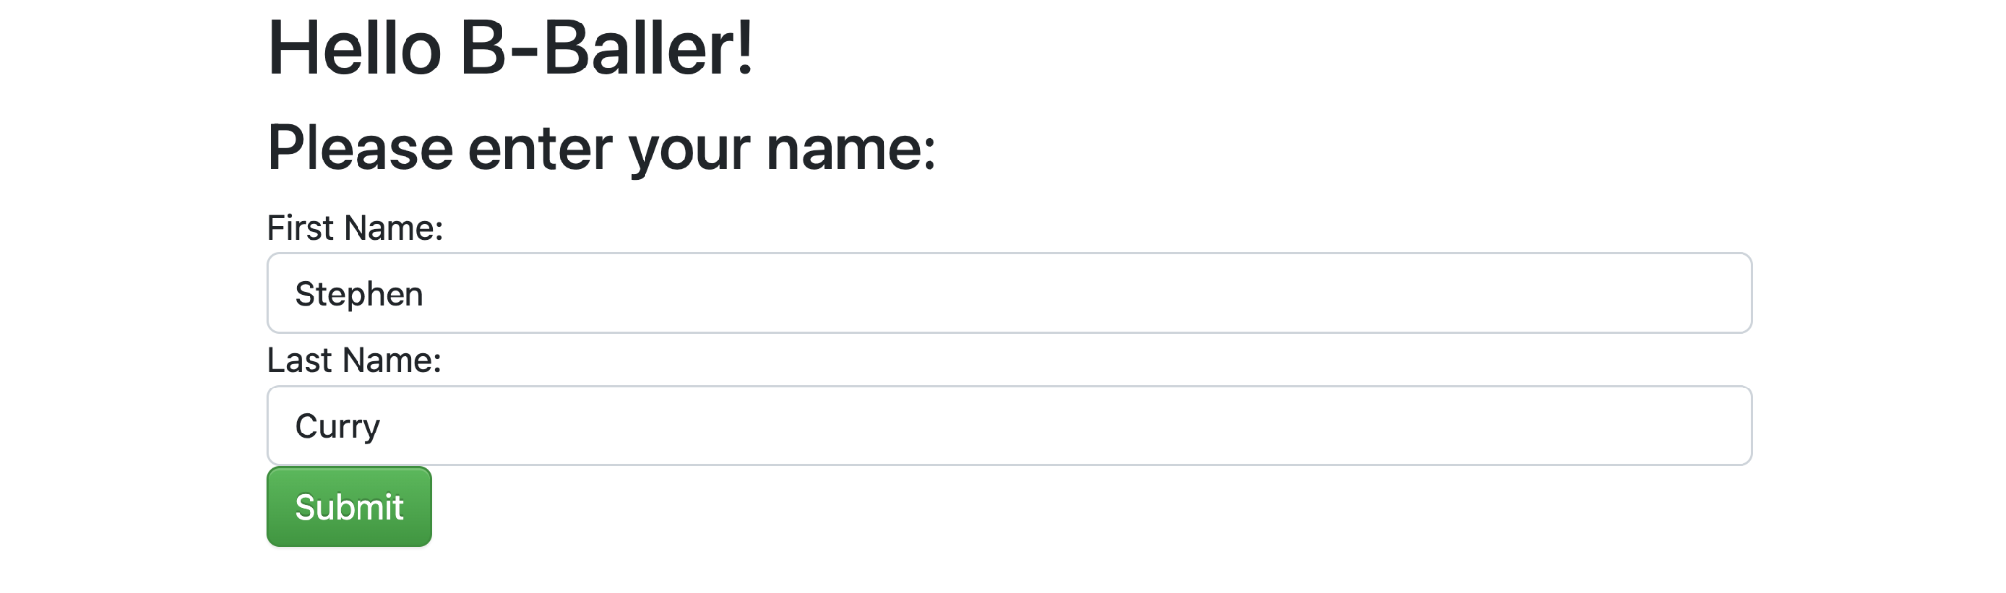

Slide 2
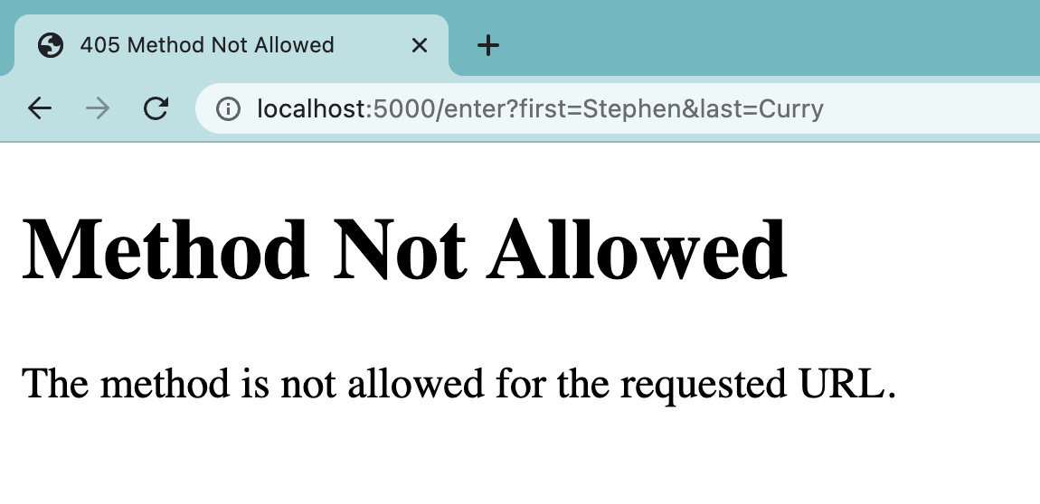
Notes:
What should you look at first?

Slide 3
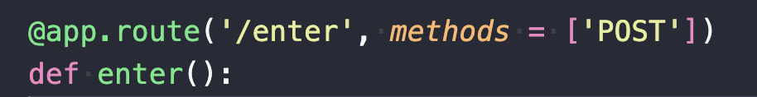

index.html
server.py

Slide 4
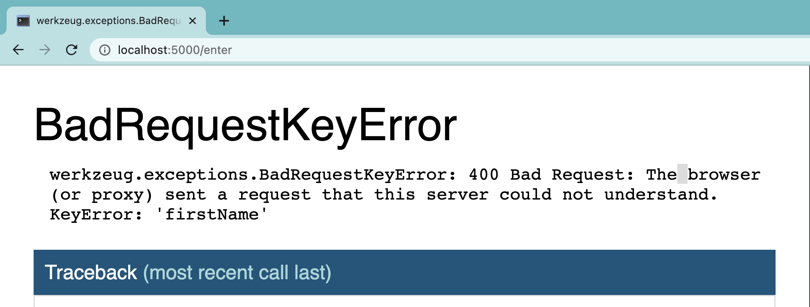
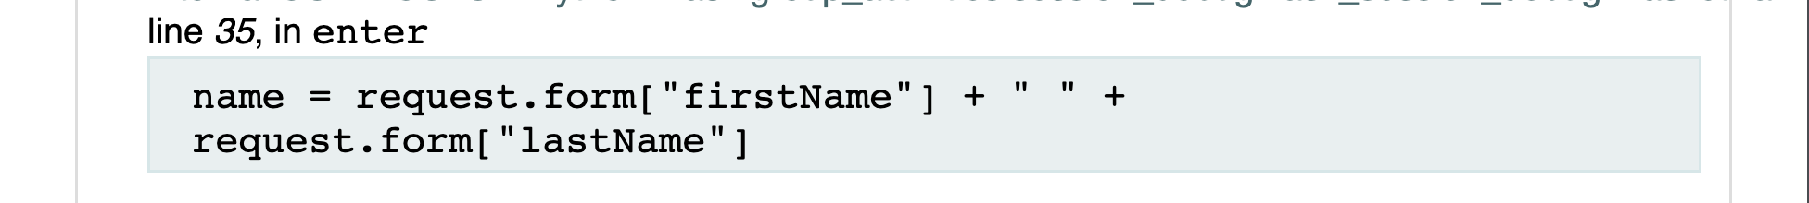
Error 2:

Slide 5
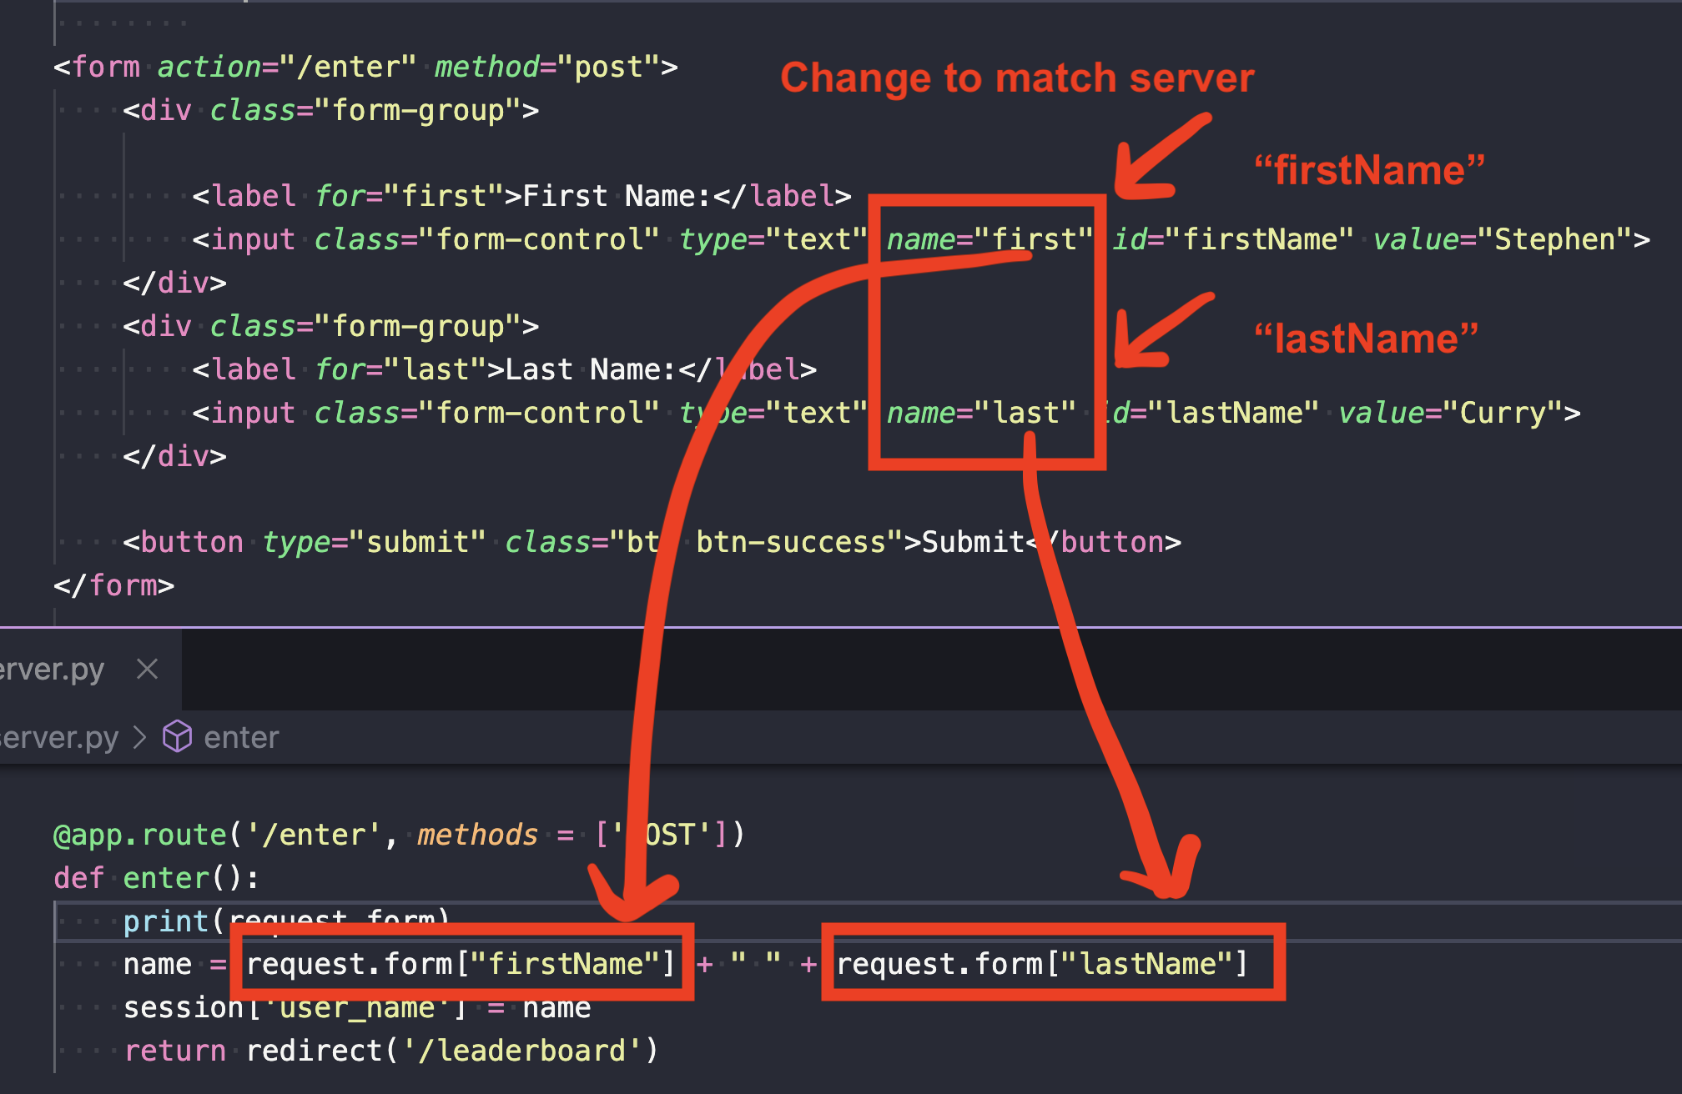

Slide 6
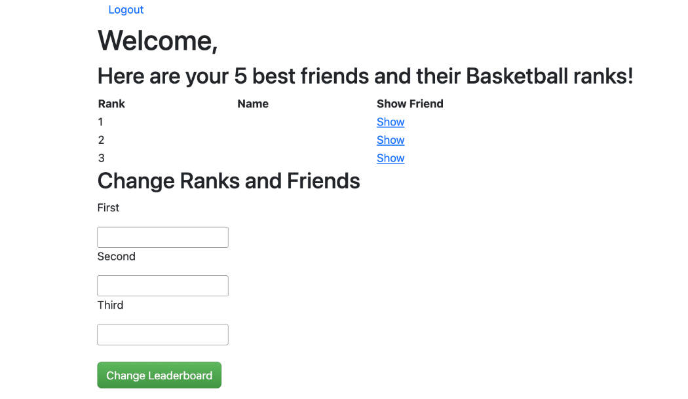

Slide 7
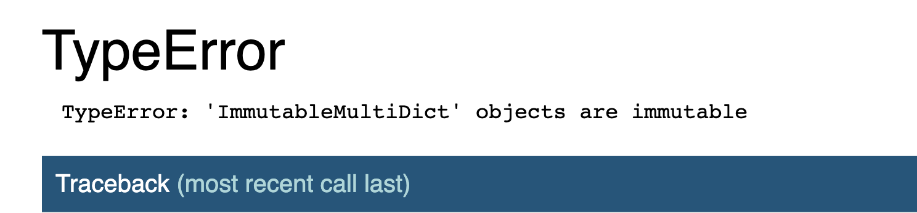

Slide 8
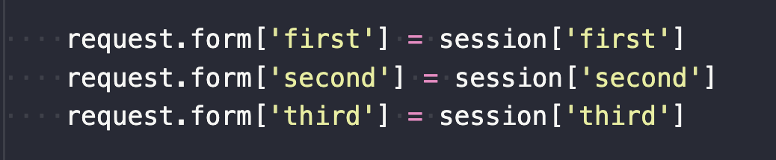
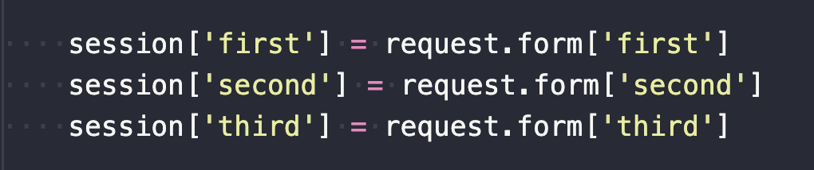
Immutable dictionary - you may not change any values.
We want to save the form entries in session, so session goes on the left of the assignment operator, and request.form with the values on the right.

Slide 9
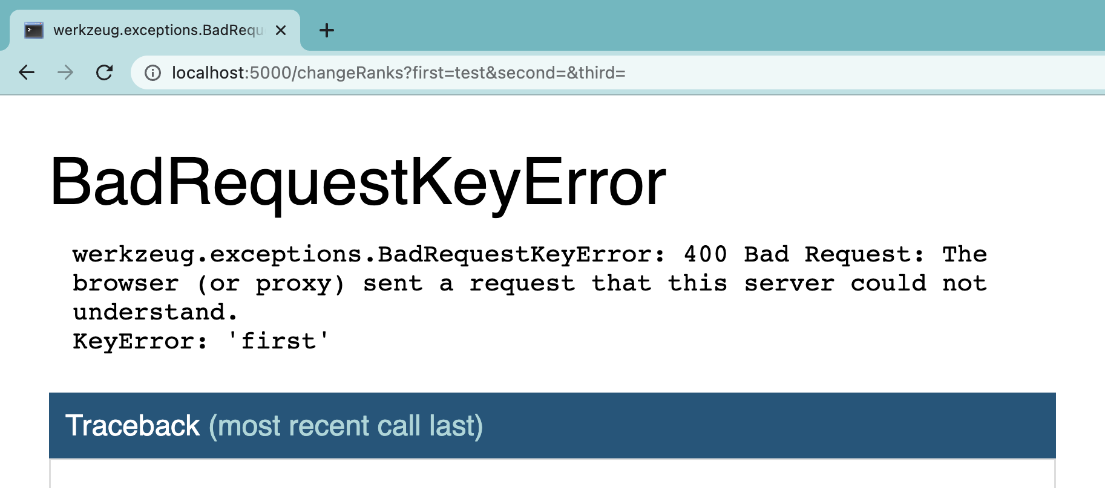
Notes:
Which dictionary is it?

Slide 10
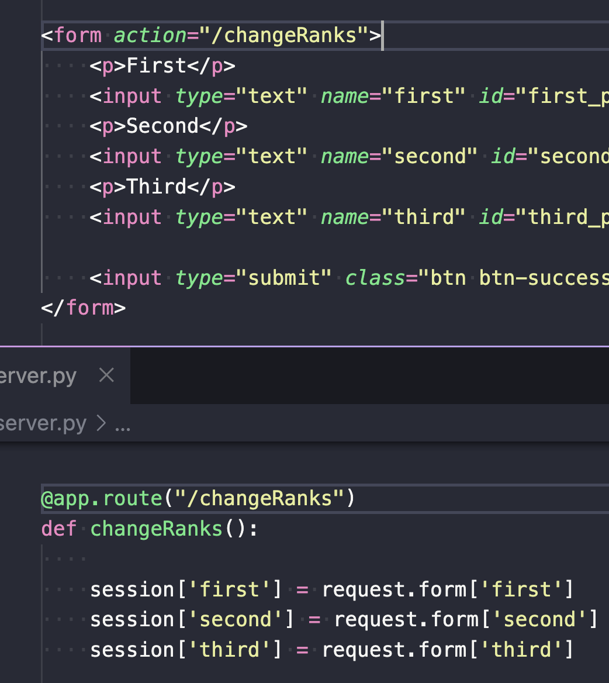
These match, so what’s going on??
We must print request.form to see..
And find that it is empty!

Slide 11
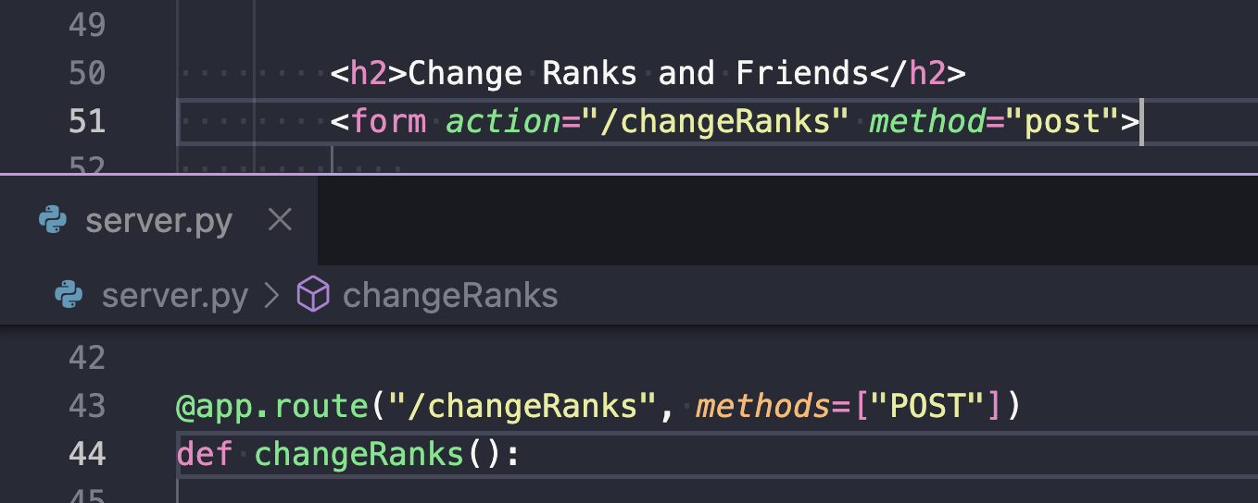
The html form and server route need to be designated as POST requests.
If sent as a GET request, the form values are sent in the URL and not the body of the request in request.form. So request.form is actually empty!

Slide 12
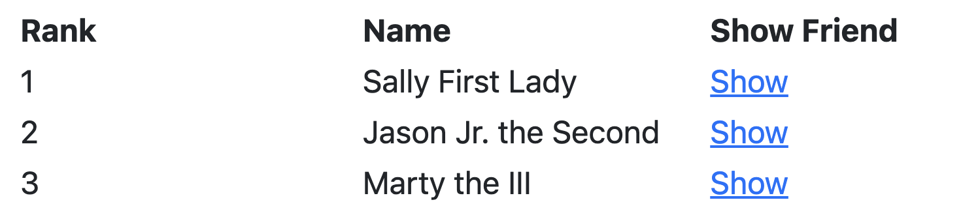
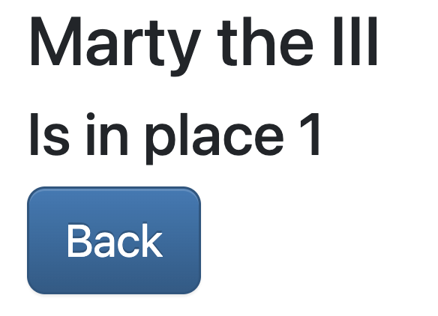
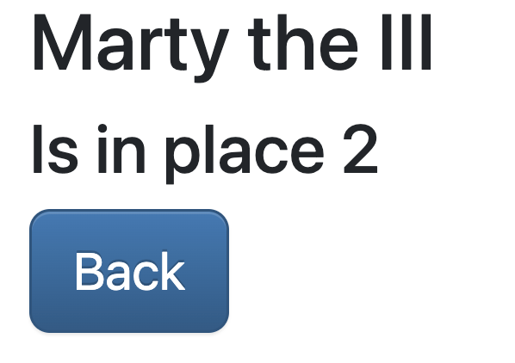
???

Slide 13
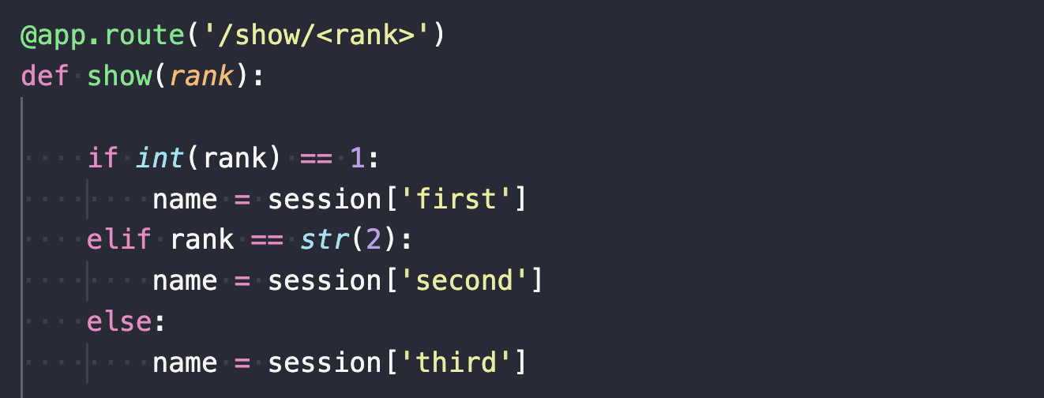
1st way
2nd way
URL path variables (<rank> ) come back as strings. You may have fixed this in any of these 3 ways
3rd way

